Slide 1
Student Affairs Chatbot -AI Assistant
Group 2 | 06-08-2025
Christo Pananjickal Baby - 8989796
Fasalu Rahman Kottaparambu - 8991782
Srinu Babu Rai - 8994032
An AI chatbot which can help and guide students regarding student affairs

Slide 2
Problem and Solution
Current Problems:
Students struggle to get delay in answers on college policies, registration, fees, mental health, campus life.
Traditional support (emails, calls, office visits) is slow, limited to office hours, and often confusing.
Staff are overwhelmed by repetitive questions - Less time for handling serious or urgent student issues.
Solutions we put forward:
A smart, easy-to-use virtual assistant that,
Provides instant answers 24/7
Supports multiple languages
Escalates serious or sensitive issues to real human staff when needed

Slide 3
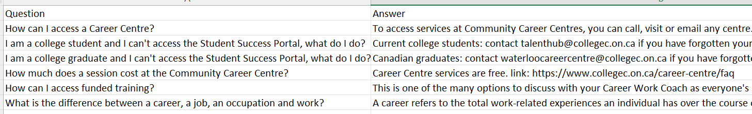
Data Corpus
The data corpus is the data scraped from a college website
Implemented Features
Sentiment Detection & Escalation
RAG for Interactions
Next question prediction
Multilingual Support

Slide 4

GROUP 2
Stakeholders
Students
Student affairs staff
College
Tech and Knowledge Vendors
Open AI
Google translator
ABC College Dataset

Slide 5
GROUP 2
Impact
24/7 instant support
Reduces repetitive staff workload
Multiple languages for inclusivity
Quick follow-ups with next question suggestions

Slide 6
01
02
03
GROUP 2
NLP Components
Normalization, Stopword filtering, Stemming
We have used different NLP components in out project. These components have help us to prepare and process the data from training as well as prompting.
Converting to lowercase, removing stopwords, words stemming
Tokenization
Splitting data and prompt into individual words using NLTK
Vectorization
Tokens are transformed into a numerical vector space from which correlated data can be found out using cosine similarity

Slide 7
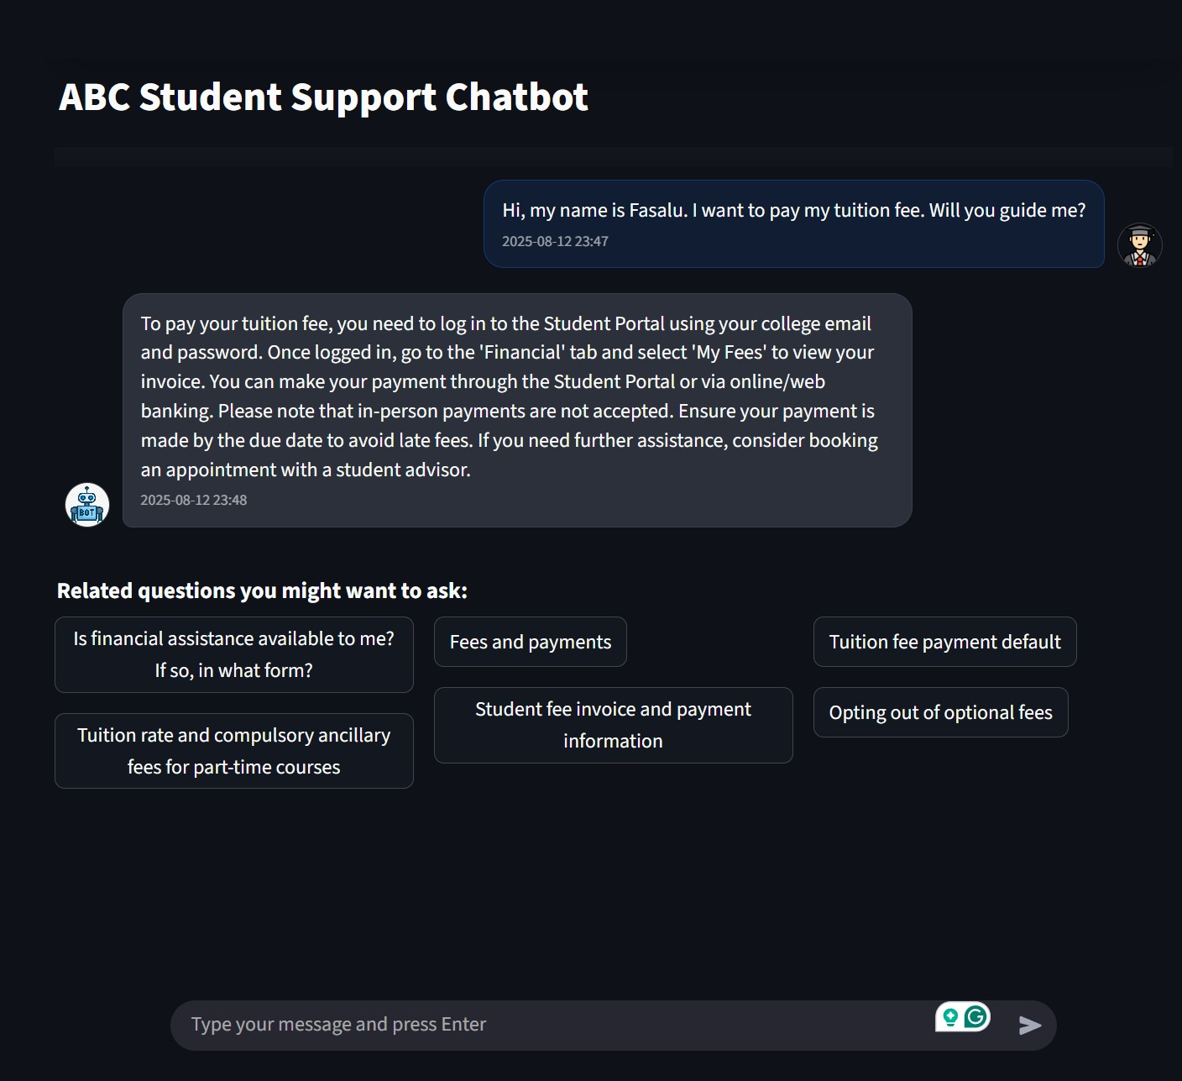
GROUP 2
Prediction
Predicts related questions at end of a conversation
Uses Logistic Regression with re-ranking (sorting)
Model trained once and saved
Faster navigation
Chat bot user interface
The above is the user interface of our chat bot that we have developed.

Slide 8
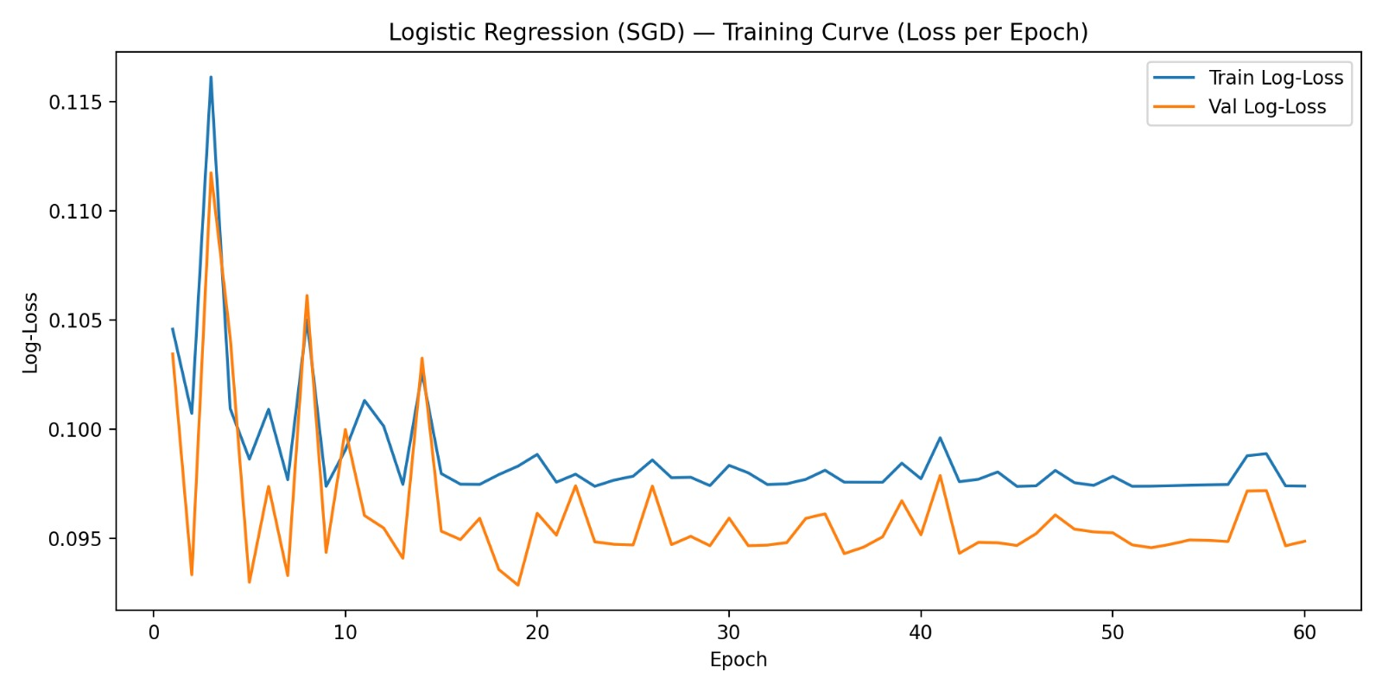
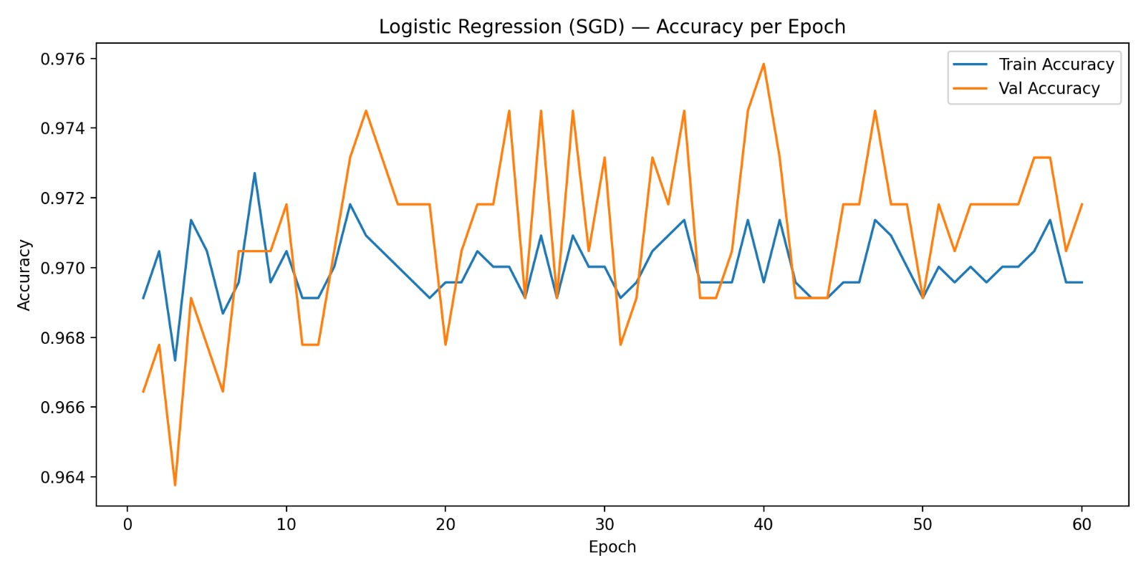
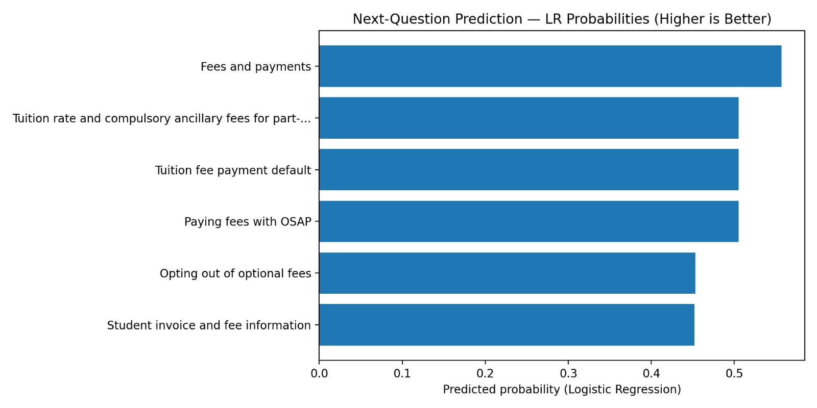
GROUP 2
Prediction Training Results
Evaluation Metrics
Metric | Value
Accuracy | 97.18%
Precision | 86.30%
Recall | 85.13%
F1 Score | 85.71%

Slide 9
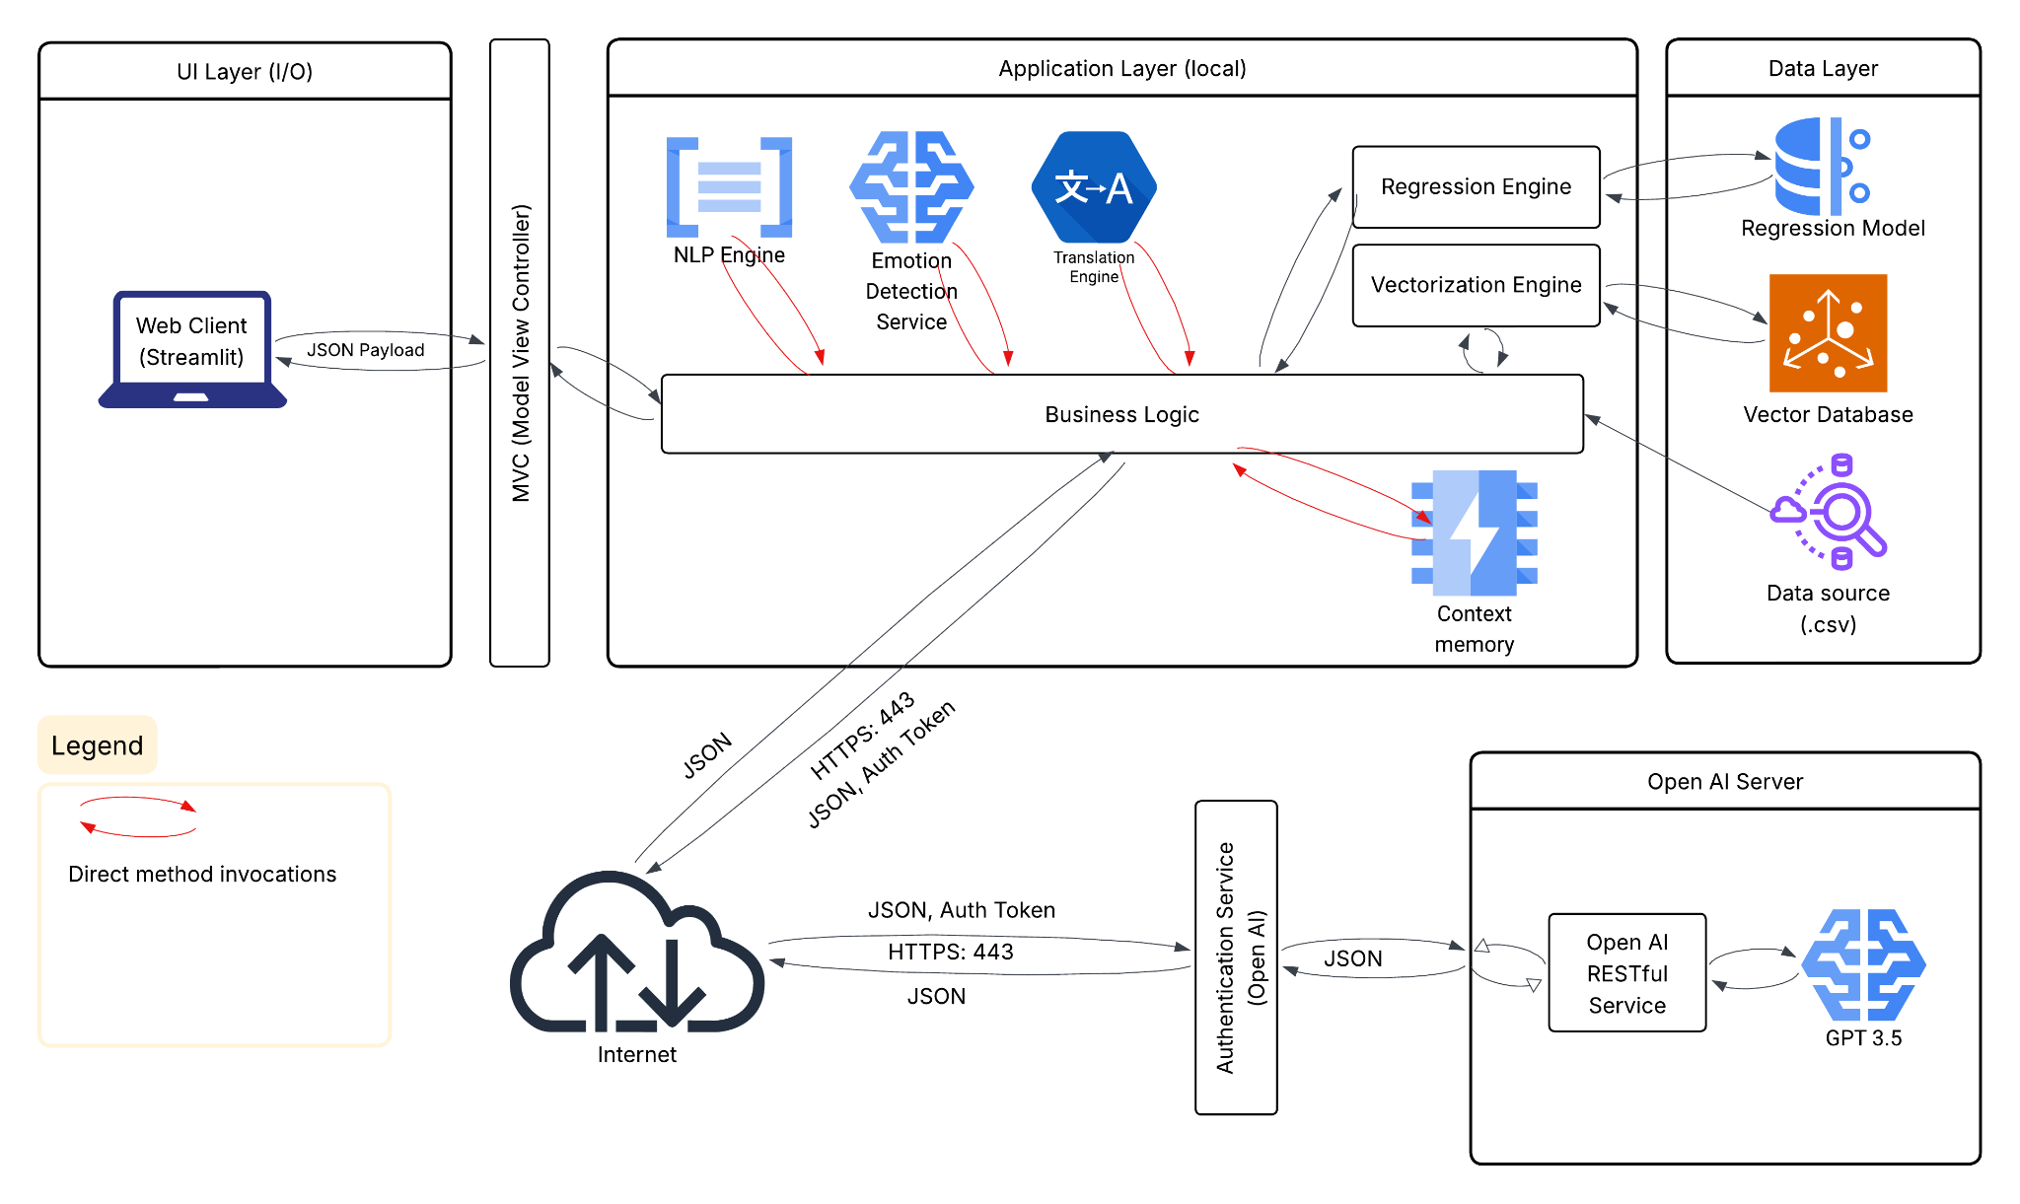
GROUP 2
Software Architecture

Slide 10
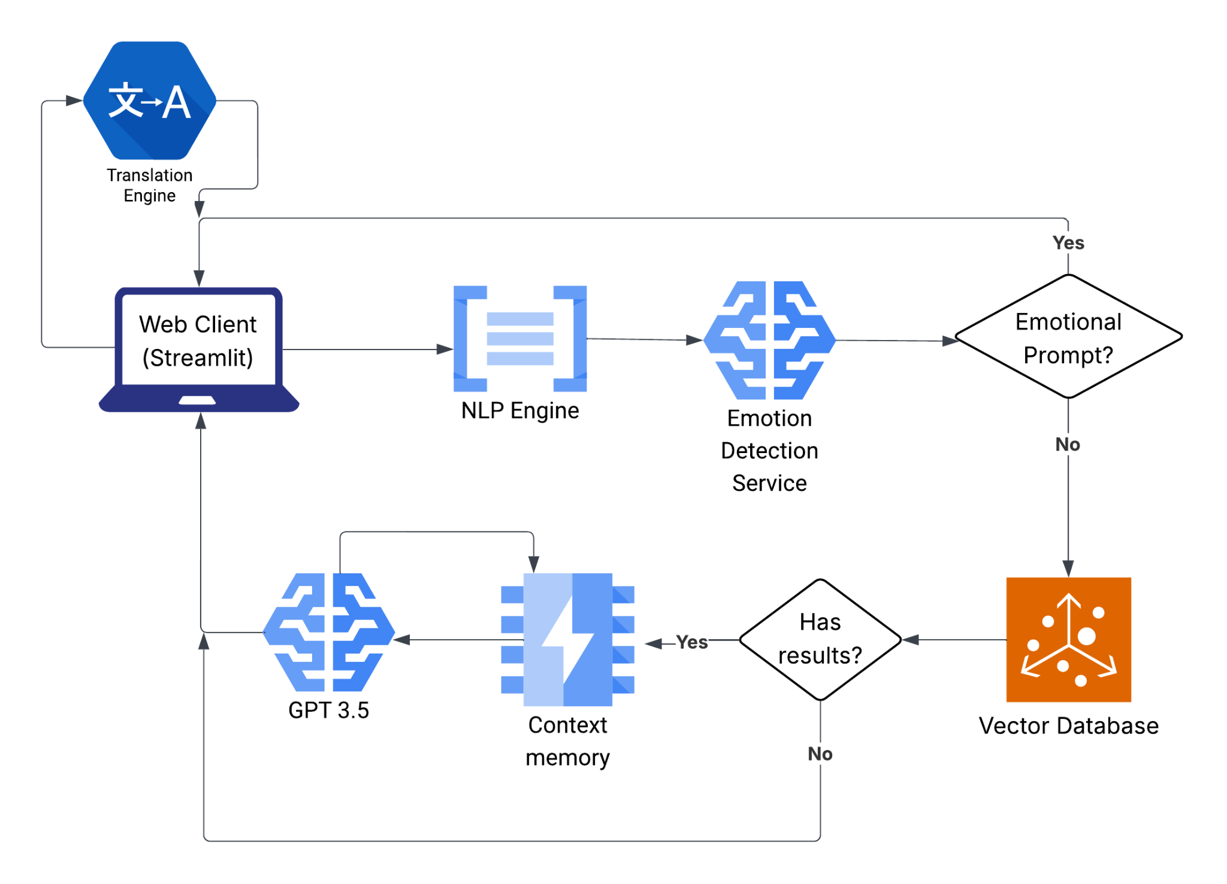
GROUP 2
Data Flow Diagram

Slide 11
GROUP 2
LIVE DEMO

Slide 12
GROUP 2
Future Plans
Add analytics dashboard - top rated questions, usage, prediction performance, response efficiency, find areas to improve
Expand multilingual support
Integrate with college student portal

Slide 13
Thank you!
- Group 2
06-08-2025

